Slide 1
Large Language Models

Slide 2
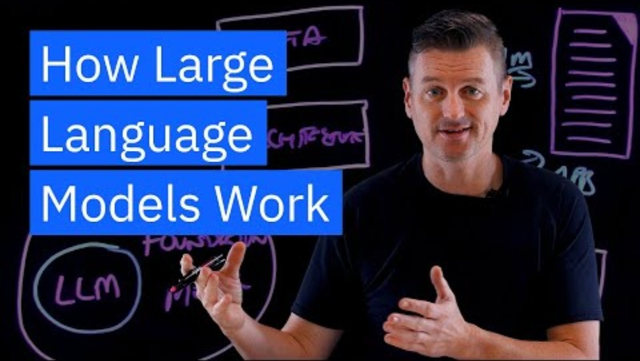
Input I from Users
A YouTube Video

Slide 3
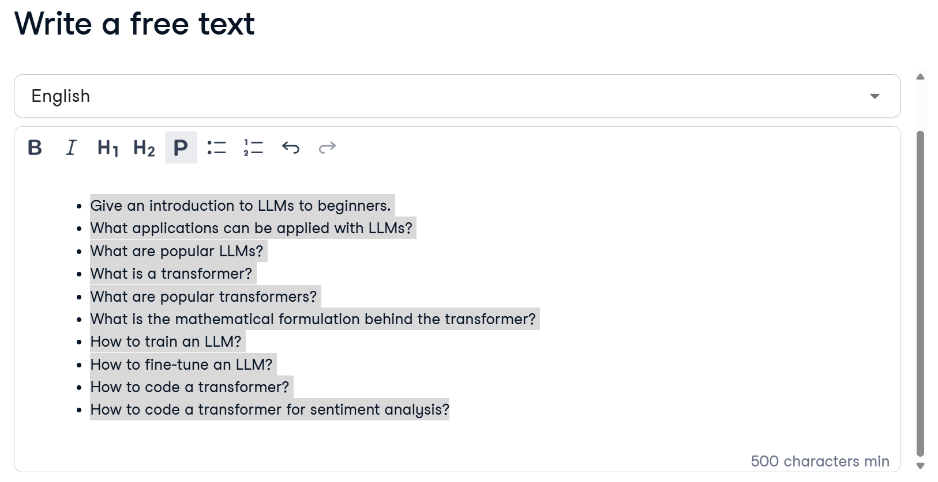
User Input 2
Outline
Give an introduction to LLMs to beginners.
What applications can be applied with LLMs?
What are popular LLMs?
What is a transformer?
What are popular transformers?
What is the mathematical formulation behind the transformer?
How to train an LLM?
How to fine-tune an LLM?
How to code a transformer?
How to code a transformer for sentiment analysis?

Slide 4
Output
Interactive video
Summary
Course materials
Quizzes
Chatbot

